Slide 1

Step 5 – Feed-Forward Network (FFN)
Adding Non-Linearity and Depth to Each Token's Understanding

Slide 2

Where We Are in the Encoder
Each token has already journeyed through multiple transformation stages in the encoder:
01
02
Self-Attention
Add & Norm
Tokens learn contextual relationships from surrounding words in the sequence
Residual connections and normalisation stabilise the learning process
03
Feed-Forward Network
Deep non-linear transformations help each token learn richer, more abstract semantic meanings

Slide 3

What Is the Feed-Forward Network?
The FFN is a small neural network applied individually to every token vector in the sequence. Importantly, the same network with identical weights is used across all positions.
This uniform application is why it's called Position-wise FFN – each position gets the same treatment, but the operation happens independently for each token.

Slide 4




Why Do We Need FFN?
The Feed-Forward Network serves several critical purposes in the transformer architecture:
Add Depth
Richer Understanding
Applies deeper non-linear transformations to each token's representation
Enables the model to learn complex, abstract patterns beyond linear relationships
Independent Processing
Complements Attention
Works on each token separately after it has already acquired context from attention
Attention mixes tokens together; FFN refines each one individually

Slide 5
Mathematical Formulation
The Feed-Forward Network applies two linear transformations with a ReLU activation function in between:
Understanding the components:
Symbol
Meaning
x
Input vector from the previous layer (post-attention)
W₁, W₂
Weight matrices – learned parameters that transform dimensions
b₁, b₂
Bias terms – additional learnable parameters for each layer
ReLU()
Activation function that keeps positive values, sets negative values to zero

Slide 6
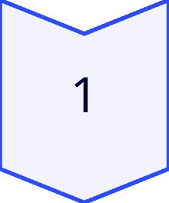
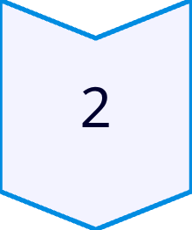
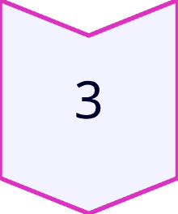
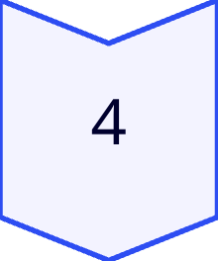
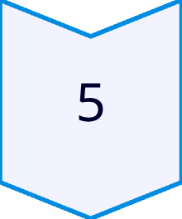
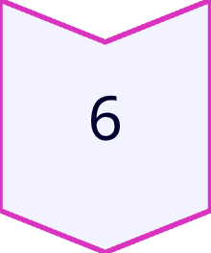
Step-by-Step Flow
Let's trace how a single token vector transforms through the FFN:
Input Token Vector
Start with token embedding x (512-dimensional)
First Linear Transformation
Multiply by W₁ → expand dimensions (512 → 2048)
Apply ReLU Activation
Introduces non-linearity by zeroing negative values
Second Linear Transformation
Multiply by W₂ → compress back (2048 → 512)
Add Bias Terms
Include learnable biases b₁, b₂ at each layer
Output Refined Vector
Final enriched representation (512-dimensional)

Slide 7
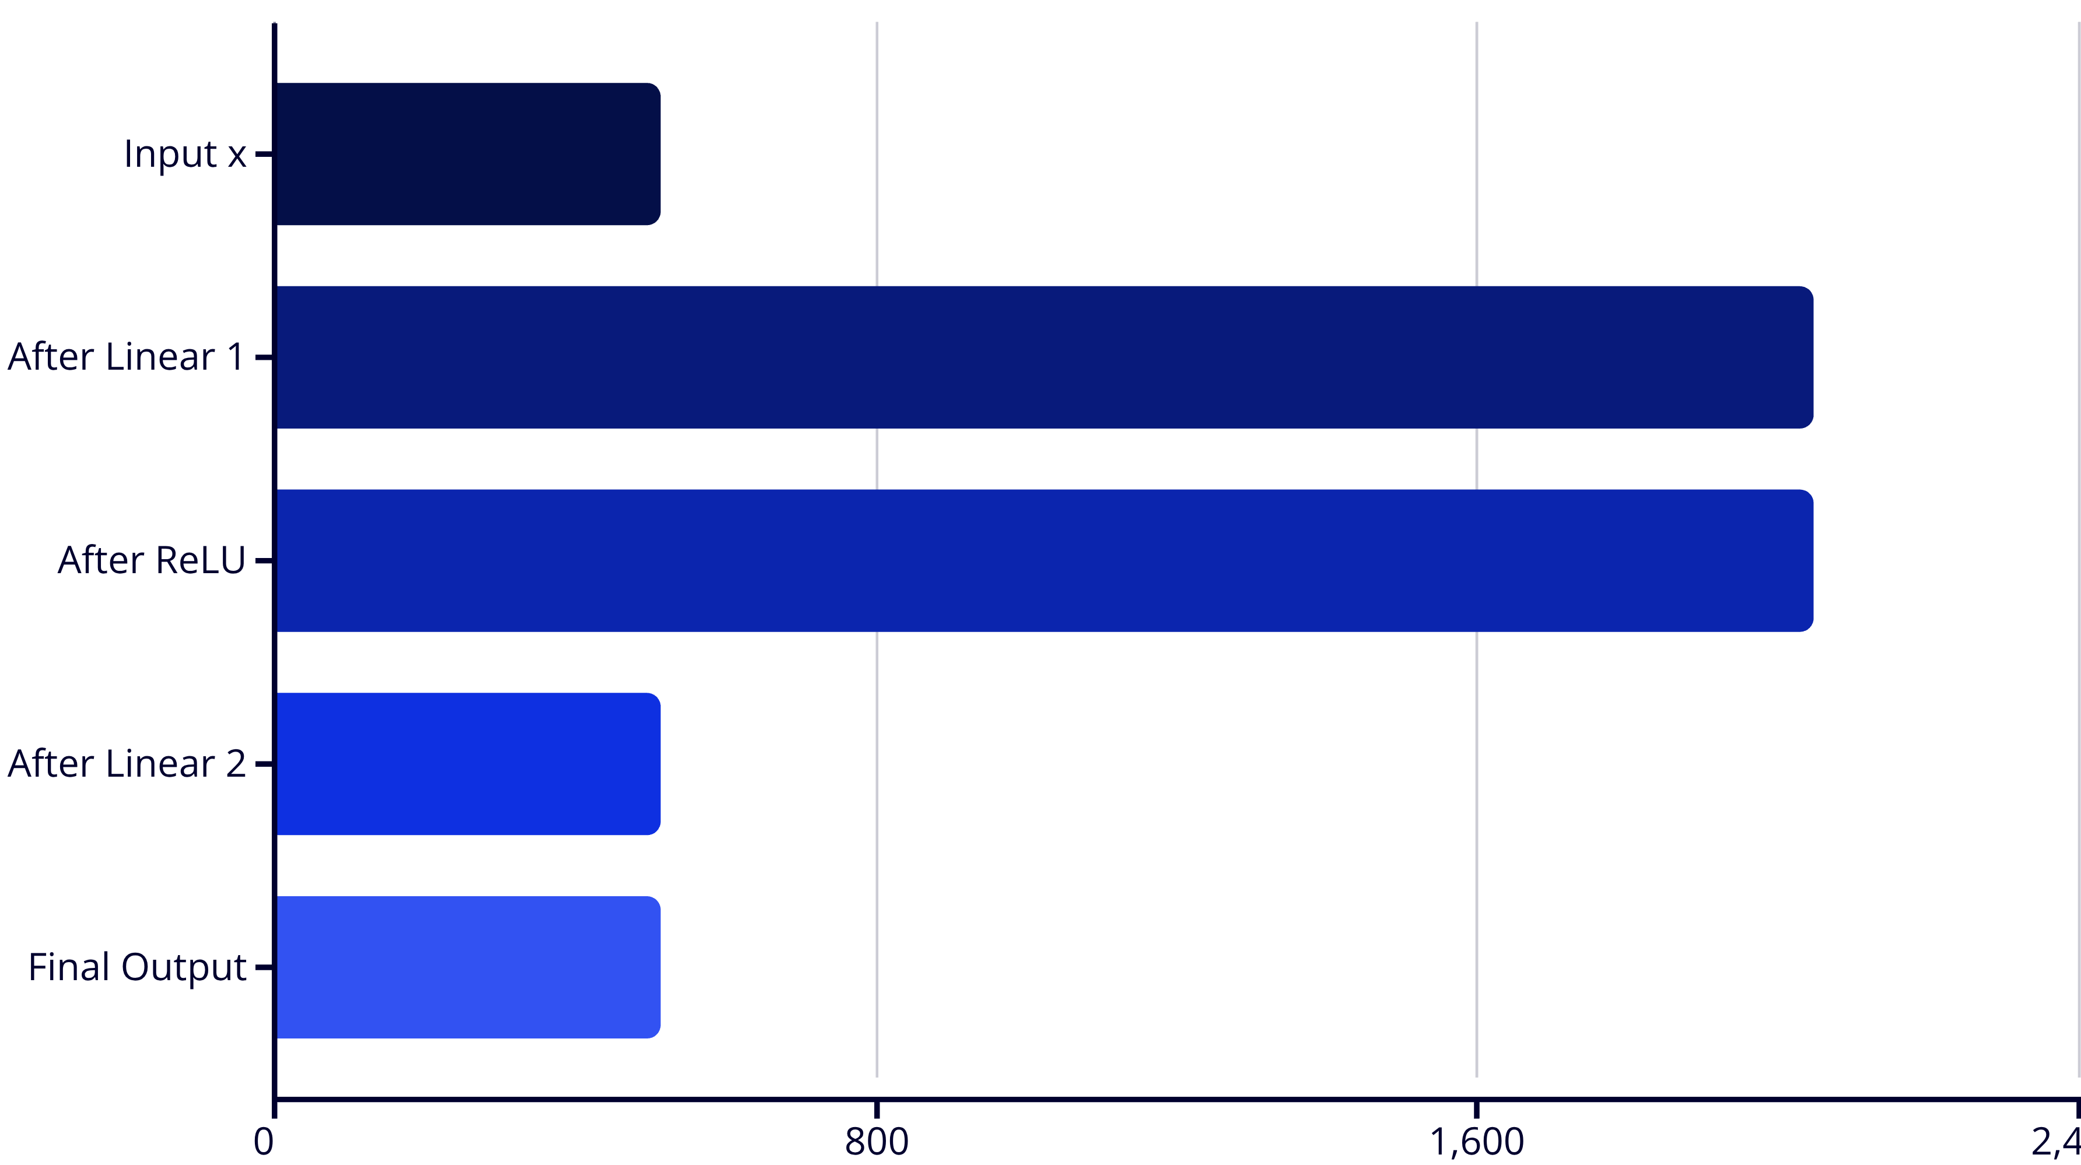
Example with Shapes
Here's how tensor dimensions change as we pass through each operation in the FFN:
The key insight: each token's embedding is stretched to a higher dimension, activated non-linearly, then compressed back to create a richer, more expressive representation.

Slide 8


Why Apply Separately to Each Word?
Context Already Acquired
Individual Refinement
Shared Weights
Each token already has context from the attention mechanism
FFN refines its own meaning individually, not other tokens
The same FFN with identical weights is reused across all positions
Think of it this way: "Every word now knows the context from attention – the FFN lets us polish and refine what each word means individually."

Slide 9

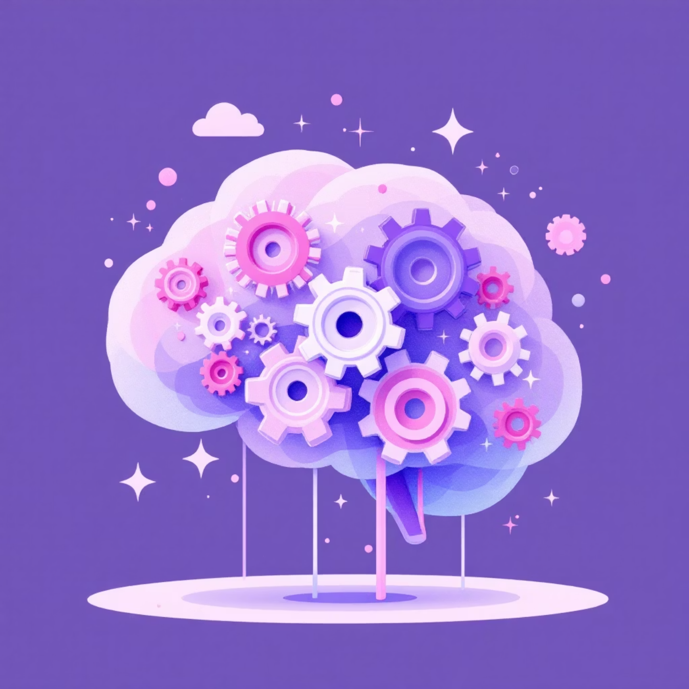
Intuition Analogy
🧩 Attention
⚙️ FFN
How words talk to each other and share information across the sequence
How each word processes what it heard and deepens its understanding
The FFN gives the model "brainpower" to combine features in non-linear ways, enabling it to capture complex relationships that linear transformations alone cannot express.

Slide 10
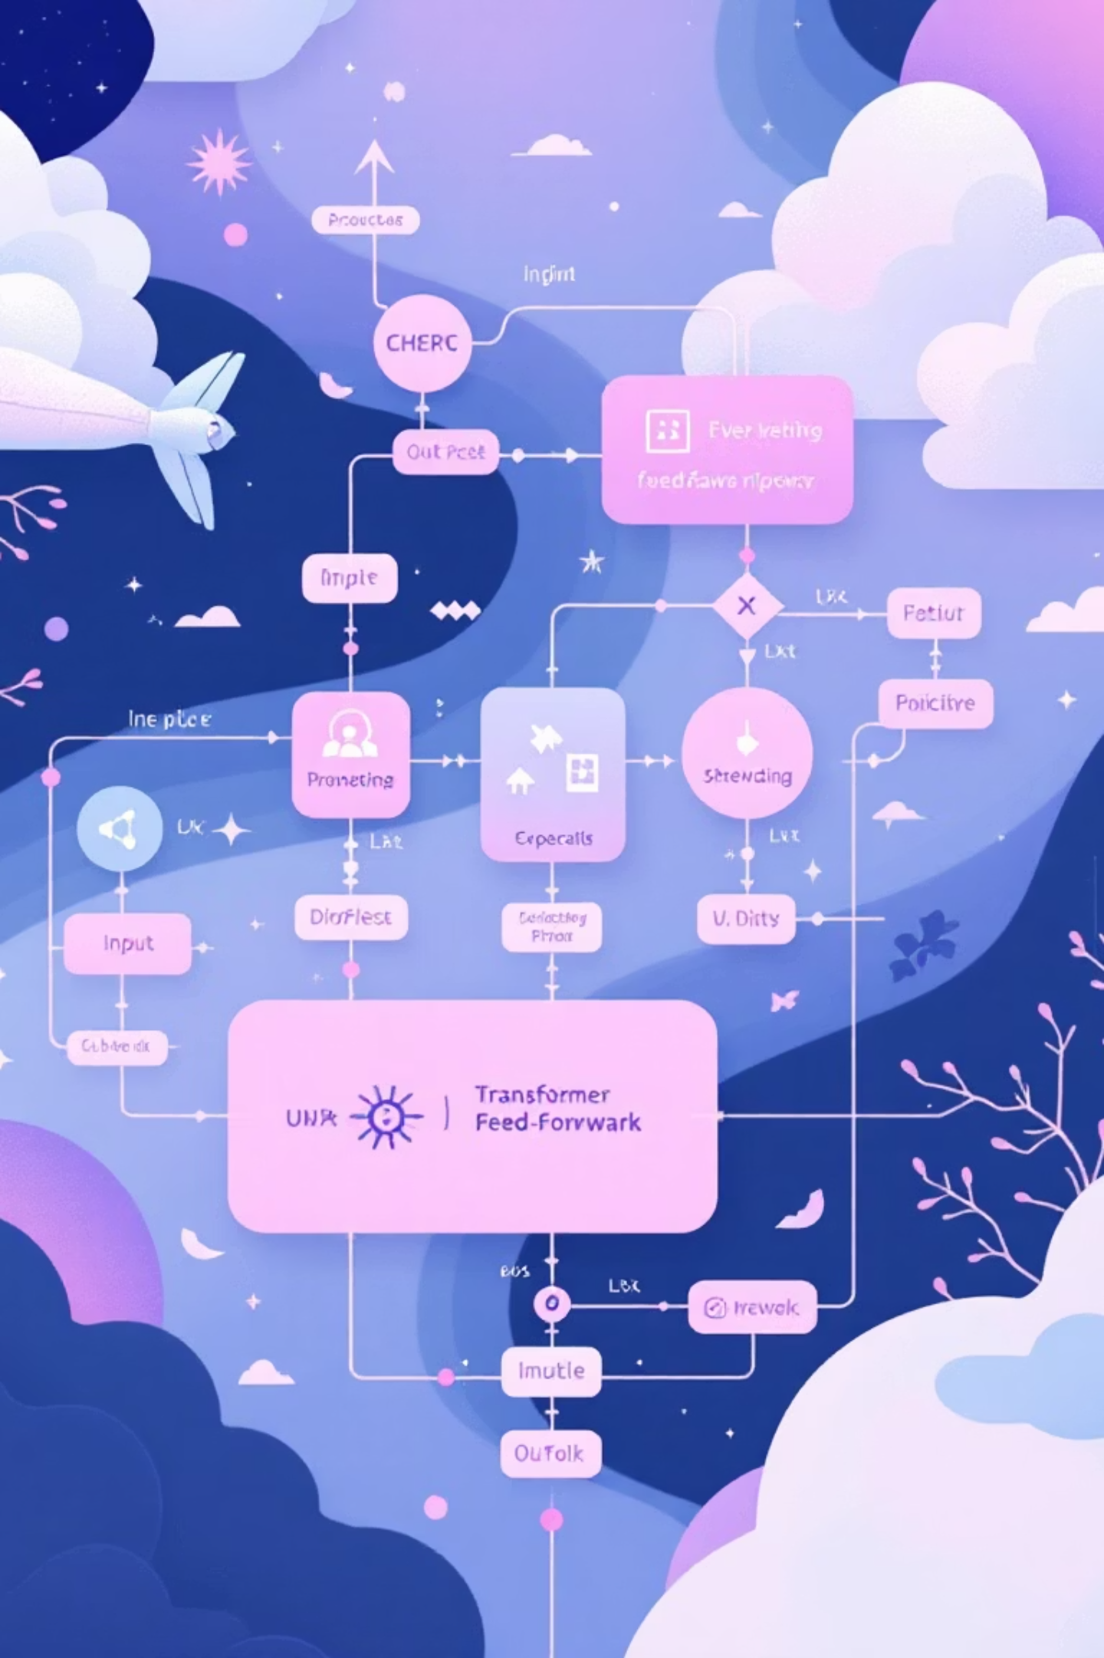
Quick Recap
1️⃣ Input
2️⃣ Transform
Contextualised word vector from attention + normalisation
Linear + ReLU + Linear creates non-linear transformations
3️⃣ Output
Refined representation maintaining the same dimension
✅ Purpose
🔁 Application
Adds depth, expressivity, and non-linearity to the model's representations
Applied to each token individually in a position-wise manner

